Slide 1

SDPR : Research Paper Ranking using semantic relatedness
By Chinmay Murugkar
Committee :
Dr. Lakshmish Ramaswamy
Dr. Hamid Arabnia
Dr. Budak Arpinar
Master of Science
Department of Computer science
University of Georgia

Slide 2
outline
Introduction
Motivation
System Architecture
Semantic Distance Calculator
Term Weight Calculator
Experimental Evaluation
Related Work
Conclusion

Slide 3

an Introduction
Research papers publications increasing exponentially
Filtering research papers
Ranking Goal = similarity between Query <-> Paper
Parameters in conventional algorithms
Difference in research paper ranking platform and www searching
Different Document Ranking models

Slide 4
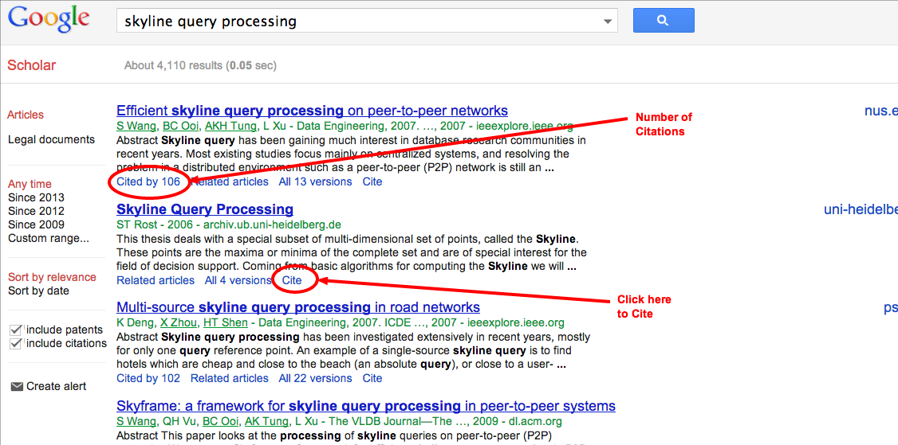
Citation based and tagged based systems
Google scholar and Paper Rank system
In Google scholar,
Score = number of paper
citations + number of times
Paper cited
PROBLEMS :
Knowledge base availability
Number of citations for field of interest
Lack of context decision
Existence of multiple copies of research paper
Justify – What is not addressed in these systems that , what problem compelled u to do this research. What is the motivating factor. What is that special thing that compelled u to do this research

Slide 5

Stages of research paper ranking system
GOAL = Rank Research Papers from huge cluster of papers
Research Papers
Ranking System
Query
Ranked
Papers
Indexing &
Organizing
Indexed
and structured
information
Retrieval

Slide 6


Problems in research paper Ranking
Research Paper Processing problems :
Identifying the context of the document
Coherence between the words
Polysemy
Synonymy
Query Processing Problems :
Context of the query
Query disambiguation
Identification of significant words in query

Slide 7


SDPR
We Present SDPR : an efficient
search framework for ranking research papers
We have three features in this system :
Word classifier which that helps in identifying the context of the query and separate out significant terms in the query – Justify [how disambiguation, why disambiguation, how this system differs than other research out their]
Semantic distance calculator to understands coherence between words and helps in following

Slide 8
Reasoning
Word classifier :
Some of them consider word probablities
Speed matters
Other systems just word considered
Here, synonyms are considered in word set – helps in separating out significant words in synset too
BoW Model - Bag of Words model used

Slide 9

Measure degree of semantic relatedness between query words and research paper.
Identify context of research paper.
Disambiguation of search query – Justify [how disambiguation, why disambiguation, how this system differs than other research out their]
To endorse the quality of research paper ranking we introduce weight calculator

Slide 10
reasoning

Slide 11
System architecture
Explain each and every detail of the how this is stored, how it is done….
Research Papers
User Query
Document
Normalizer
Query
Pre-processing
Data
Repository
Word
classifier
Wordnet
Ontology
Document
Indexer
Indexed
File
Word Inverted
Index
Research paper
Ranking
R

Slide 12
System architecture
Research Papers
User Query
Document
Normalizer
Query
Pre-processing
Data
Repository
Word
classifier
Wordnet
Ontology
Document
Indexer
Indexed
File
Word Inverted
Index
Research paper
Ranking
R

Slide 13
Reasoning
Document Normalizer :
Data Repository : why owl and no other database schema
Document Indexer :
Indexed File : how its stored

Slide 14
System architecture
Research Papers
User Query
Document
Normalizer
Query
Pre-processing
Data
Repository
Word
classifier
Wordnet
Ontology
Document
Indexer
Indexed
File
Word Histogram
Research paper
Ranking
R

Slide 15
Reasoning
Word Histogram : Datastructure used for that and the reason to use that DS
HashMap – Why ?
BOW model
No link between words
Fast access

Slide 16


Query pre-processing
Word Boundaries
Lemmatization
Stop word removal
Case folding
Synset formation
Query = Network
After Pre-processing :
S_{m} <networking, network, mesh, web, meshing, meshwork, net, communication system>
How many words in wordnet, how big it is -- Justify

Slide 17
Reasoning
Wordnet size
How many words are present in der
Query Preprocessing : Algorithm used for each of them
Lemmatization -
Stop word removal
Case folding
Synset formation

Slide 18
Word classification
Words which tend to be more frequent are less important
Thus, we compute Frequency Threshold of query word set ‘S_{m}’
, Here f(w_{q}) = frequency of each word, n_{q} = no. of terms in S_{m}
Eg : Let, F_{T} = 97; f(W₁),f(W₃),f(W₇) < F_{T}
and f(W₂),f(W₄),f(W₅),f(W₆) > F_{T}
S_{m}
W₁
W₂
W₃
W₄
W₅
W₆
W₇
S_{Q}
S_{L}

Slide 19
Research paper ranking system architecture
Weight Frequency
Calculator
Wordnet
Ontology
Semantic distance calculator
Weight Calculator
Ranked Research Paper

Slide 20
Semantic distance calculator
Coherence using lexical cohesion property of the text.
Weight Semantic distances
Use of Wordnet graph based ontology for semantic distances
Use of Wordnet API to access the wordnet ontology
Eg : sd(rank,classification)

Slide 21
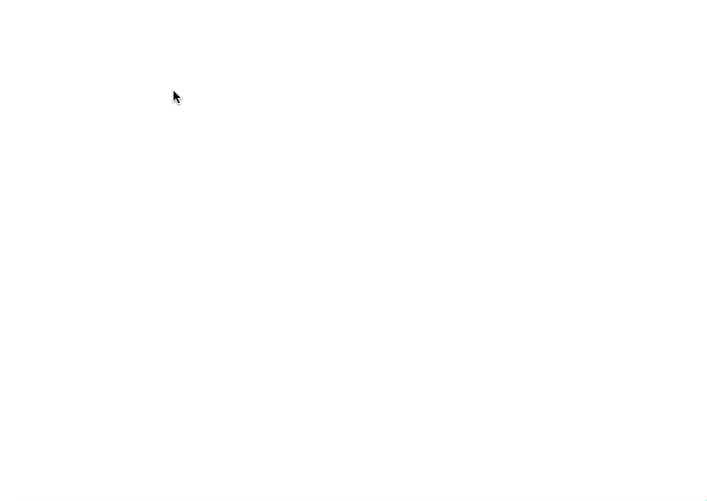
Wordnet visual Graph

Slide 22
Rita wordnet api
Rita Wordnet API is used to access the ontology based graph
Activation Algorithm : Two Inputs = w₁ and w₂
Spread activation technology
Integer encoding : noun = 1, verb = 2, adjective = 3 and adverb = 4
Example : “web12” means its noun and depth is 2
Following terms obtained for word ‘network’:
“network10”, “web11”, “WWW12”

Slide 23
Sense of each word is found at each level of depth and further nodes are activated
Identify Part of Speech using sense of word
Function used : part of speech = pos(snese_id)
Ex : pos(web10) = 1
Fuction used : number of senses = poly(snese_id)
Ex : poly(web10) = 3
Depending on the part of speech of a word and conceptual type viz.; senses, levels, synonyms and children the semantic distance weight is defined

Slide 24
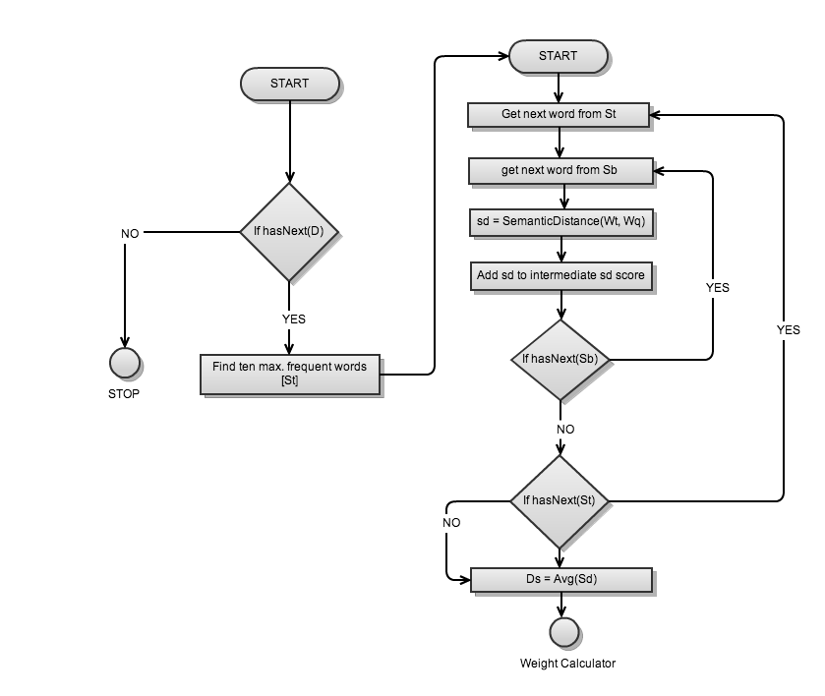
System Algorithm

Slide 25
Semantic Distance calculation
Identifying context of the document by considering set of ten most frequent words ‘S_{T}’
Find semantic distance between each word of set S_{T} and original query word set ‘S_{B}’
S_{T}
W₁ | W₂ | W₃ | W₄ | W₅ | W₆ | W₇ | W₈ | W₉ | W₁₀
…
…
S_{B}
QW₁ | QW₂ | QW₃ | QW₄ | QW₅ | QW₆ | QW₇ | QW₈

Slide 26
Semantic distance weight
Identifying context of the document by considering set of ten most frequent words ‘S_{T}’
I_{d} represents the intermediate semantic distance
Where n_{t} is the number o𝑓 terms in S_{T} Set

Slide 27
Rank of the document
PROBLEM
Endorsing rank quality
Query terms as a keyword are significant
SOLUTION
Two categories considered :
Words in S_{Q} appearing in the ten most frequent words set of D_{i} -> Exhaustivity
Words in S_{Q} appearing in documents -> Specificity
Lower the weight better is the rank of document

Slide 28
Weight Calculator
Exhaustivity : number of terms a document contains
If the Words in Query set are present in document
Consider frequency of each word in the set S_{a} for the document D_{i} considered. Thus the average frequency defined as –
Weight for document D_{i} is :
S_{Q}
W₁ | W₂ | W₃ | W₄ | W₅
W₁ | W₂ | W₃ | … | W₁₀
S_{a} {W₁, W₂, W₃}

Slide 29
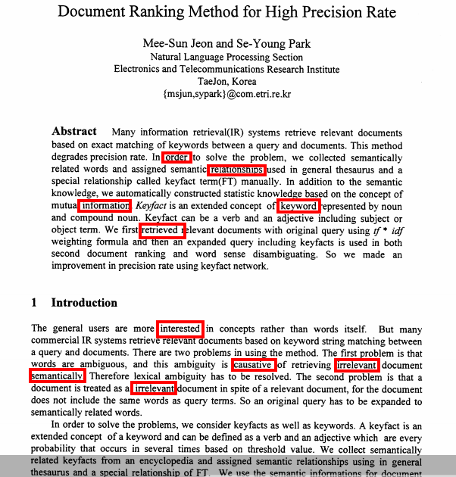
If the terms in S_{Q} appear in set S_{T} i.e. ten most frequent words in document
Consider frequency of each word in the set S_{b} for the document D_{i} considered. Thus the average frequency defined as –
Weight for document D_{i} is :
Else the weight of the document is computed using the semantic distance W_{i} calculated for document D_{i}
S_{Q}
W₁ | W₂ | W₃ | W₄ | W₅
S_{b} {W₁, W₂, W₃}

Slide 30
Experimental Setup
Dataset of 133 documents -- Justify
Tested on nine human subjects
Compared against result set from TF-IDF, Key word based system
Two Tests :
Identifying relevant papers from corpus of research papers
Identifying Flase positive and False negative out of each result set

Slide 31
Reasoning
Dataset of 133 documents

Slide 32
Parameters
Nine queries chosen based on following categories:
Keyword with no synonym
Words with synonymy and ambiguity
Hybrid Relations
Words with no coherence between words
Parameters considered for calculation:
Precision
Recall
False positive value
False Negative value
F-measure or F- precision or F – score

Slide 33
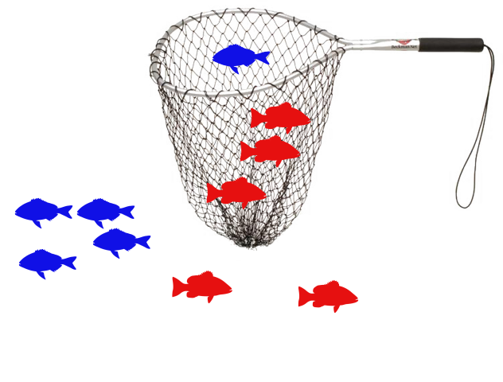
Precision recall calculation
For each query vary threshold
At each threshold find :
number of relevant documents for threshold F_{T} ‘δ’
number of retrieved documents ‘ζ’
number of actual documents relevant ‘ε’
Precision = δ / ζ
Recall = δ / ε
Precision - retrieved instances that are relevant
Recall - relevant instances that are retrieved

Slide 34
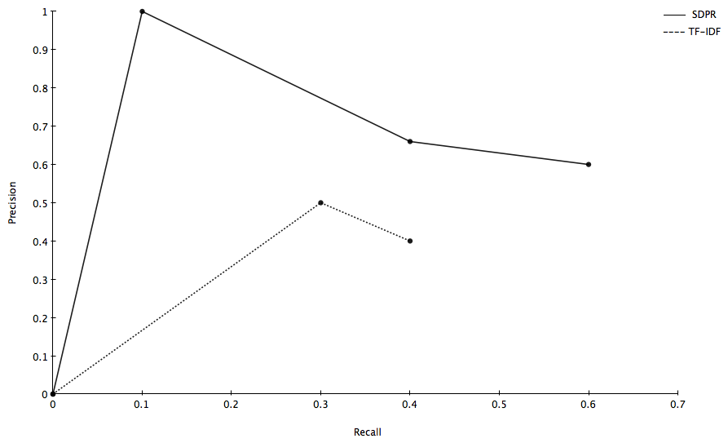
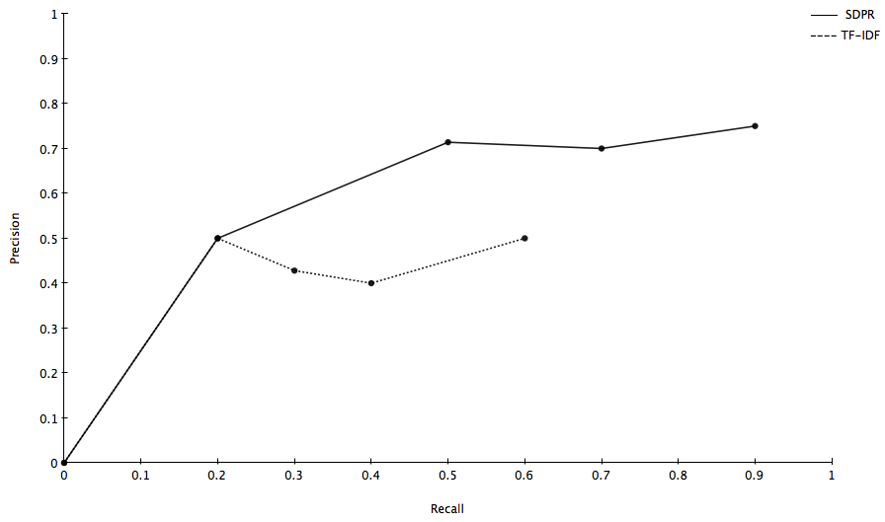
Precision Vs Recall
For
Query 7
Precision Vs Recall
For
Query 9

Slide 35
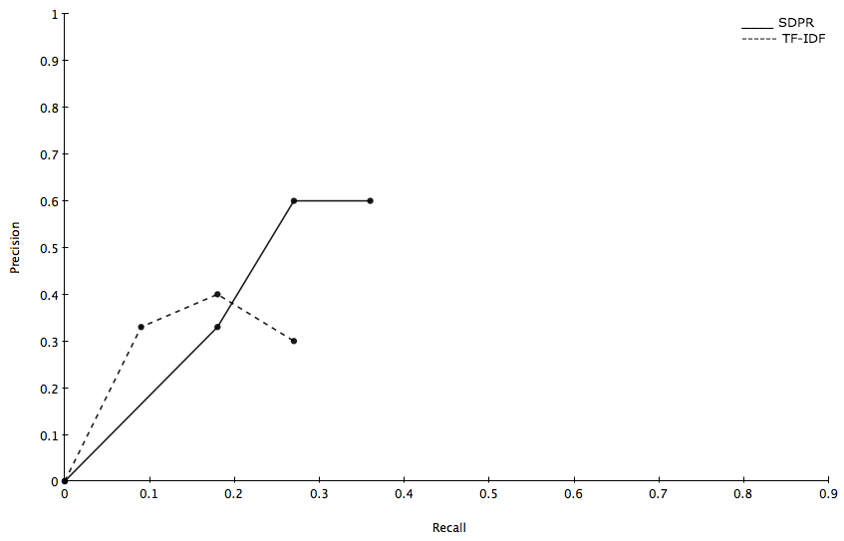
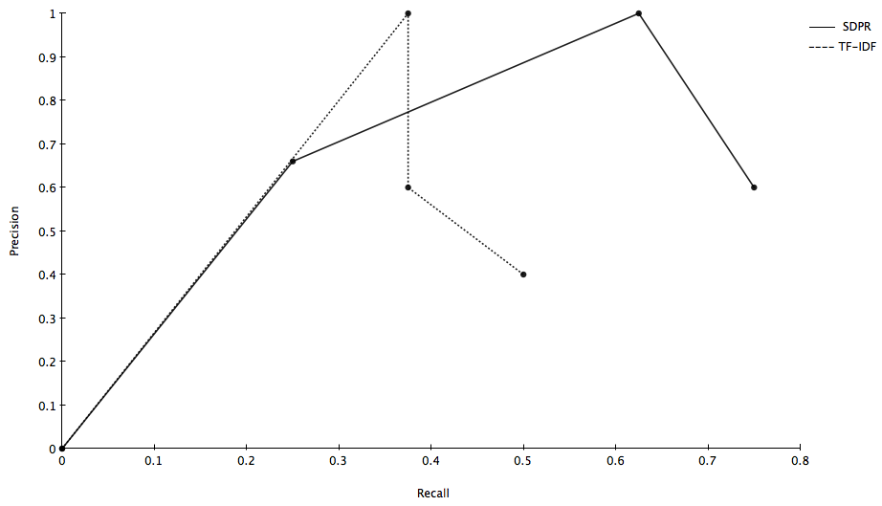
Precision Vs Recall
For
Query 5
Precision Vs Recall
For
Query 8

Slide 36
F-measure
F-measure : weighted average of the precession and recall
Best value at 1.0 and worst value at 0.0
F- score = 2 * precision *recall / (precision + recall)

Slide 37
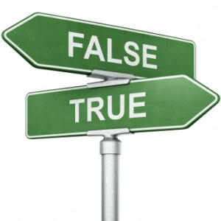
False positive and false negative
False positive -> Non- relevant results in relevant result set
False Negative -> Relevant results in Non- relevant result set
γ = false positive elements in the result set
λ = true negative elements in the result
μ = true positive elements in the result
ν = false negative elements in the result
False Positive Rate α is calculated as:
Flase Negative Rate β is calculated as:

Slide 38
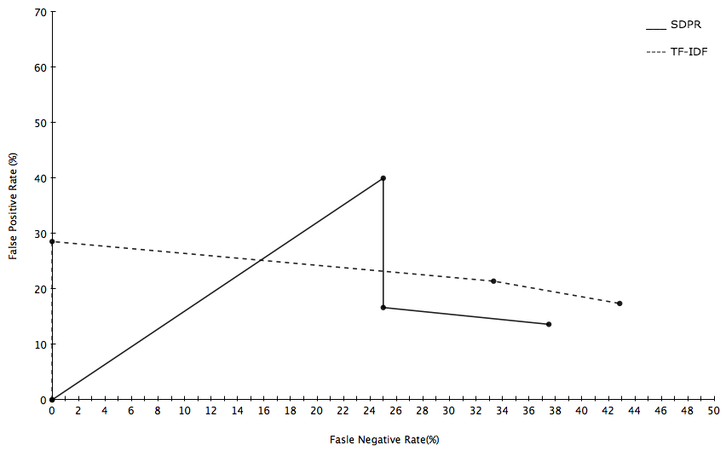
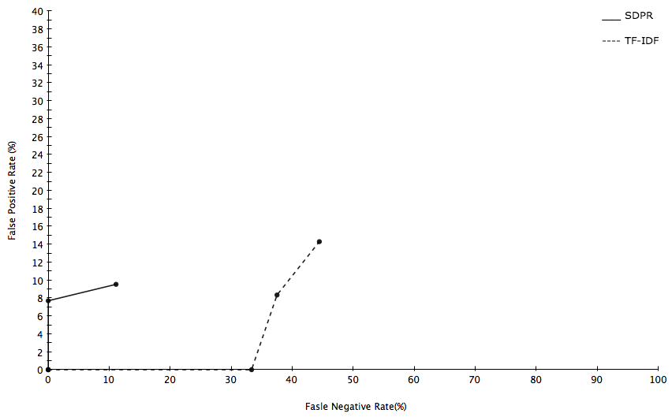
Fasle postive Vs
Fasle Negative
For
Query 7
Fasle postive Vs
Fasle Negative
For
Query 9

Slide 39
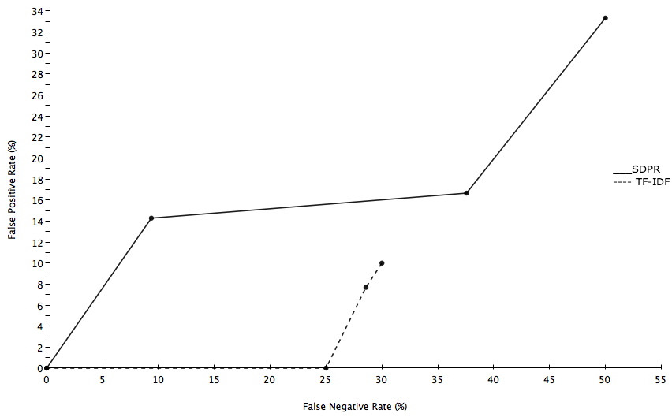
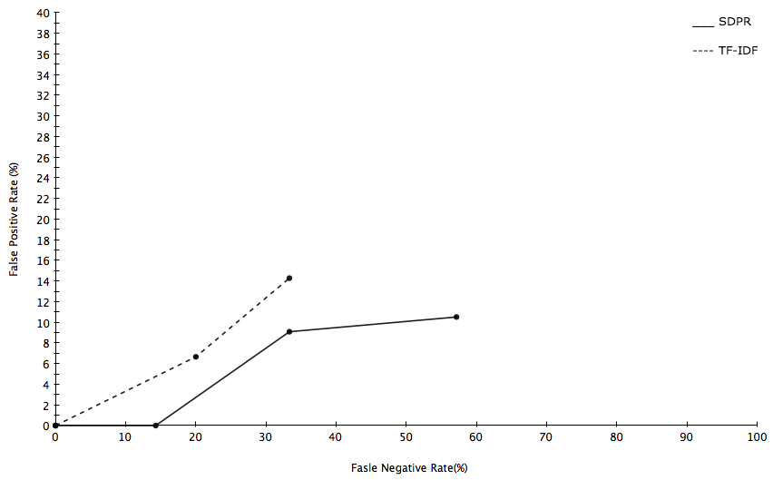

Slide 40
Related work
Ranking Documents in Thesaurus-based Boolean Retrieval Systems
Introduced E-Relevance
Use of thesaurus based algorithms to find distances
Document Ranking Method for High Precision Rate by Mee-Sun Jeon and Se-Young Park
Introduction of KeyFacts
Use od TF-IDF and expansion of query using KeyFacts
Ranking Complex Relationships on the Semantic Web
use of metadata extraction
Ranking of semantic associations

Slide 41
Conclusion
Presented SDPR
Word classifier
Resolving query ambiguity
Semantic distance weighting
Term weight calculation
In Future
Semantic links consideration
Use of Keyword tags in the system
Use of No SQL Databases and better indexing

